Slide 1


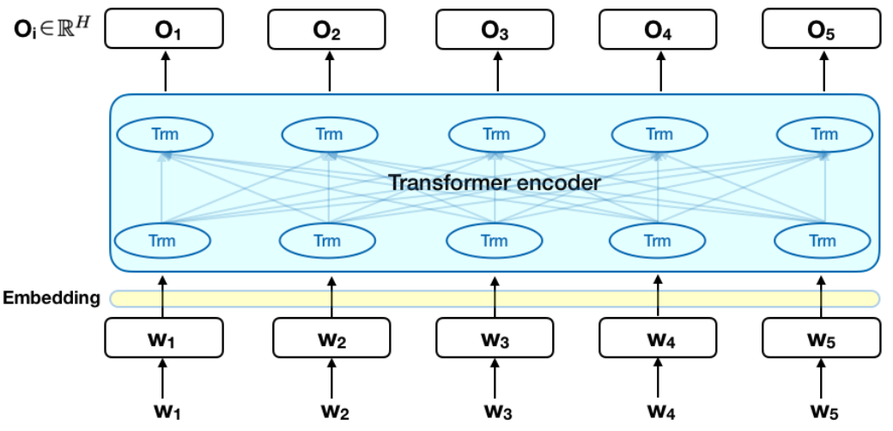
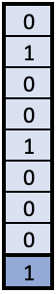
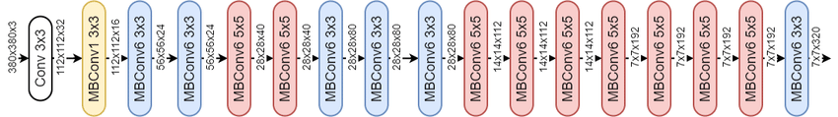
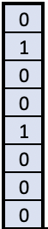

Windowing @IanPan:
> Lung
> PE
> MediaStinal
Light Augmentation vflip & shiftscale
CT Scan Sequence on Study
Dicom
Files
Subsample 4:1 -ve to +ve samples, with at least two images per study each epoch.
2048 embedding
2 X Bi-BLSTM
- 1 layer 8 head 2048 hidden
- 2 layer 8 head 1024 hidden
Extract GAP layer for train and test dim 2048, 20 epochs – using only 3 folds
Dense block 4096 X 4096
Weighted BCE
- Mean study level loss per step
–mean image level loss per step.
Ignore study loss for
negative images.
Sum LSTM & Dense layers
Mean 3 folds 12 epochs of each
Efficientnetb5
timm @rwightmann
Study level
Image level
Weighted BCE loss

Slide 2
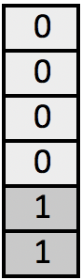
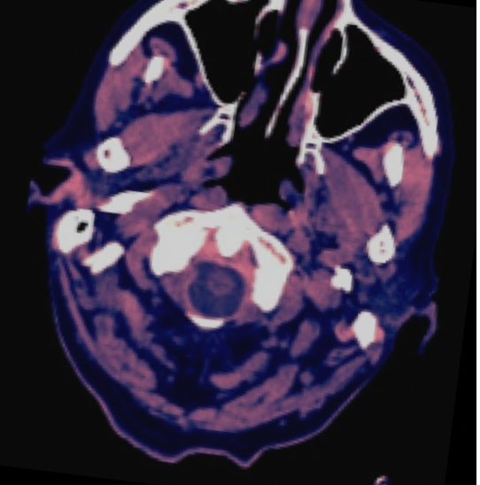
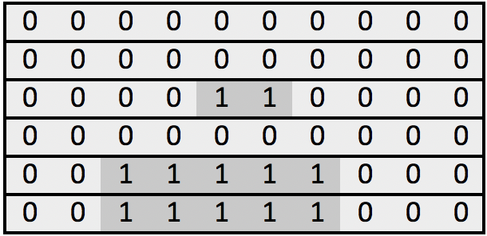
MRI Scan Sequence on Patient, Series, Study
Windowing:
> Brain
> Subdural
> Bone
Scipy ndimage
minimum_filter removes machine artifact
Augment hflip, vflip, transpose, shiftscale, brightness, resize-480 (albumentations)
Dicom
Files
2019 solution
2048 embedding
Bi-BLSTM
Extract for train and test pre-logit layer of dim 2048 for each epoch with TTA (Original, Hflip, Transpose)
Dense block 4096 X 4096
Bi-BLSTM
epidural
Intraparenchymal
Intraventricular
Subarachnoid
Subdural
any
Dense block 4096 X 4096
Sum LSTM & Dense layers
Linear layer
Classifier :
resnext101_32x8d_wsl
facebookresearch/WSL-Images
epidural
Intraparenchymal
Intraventricular
Subarachnoid
Subdural
any

